Slide 1
Ratio and Proportion

Slide 2
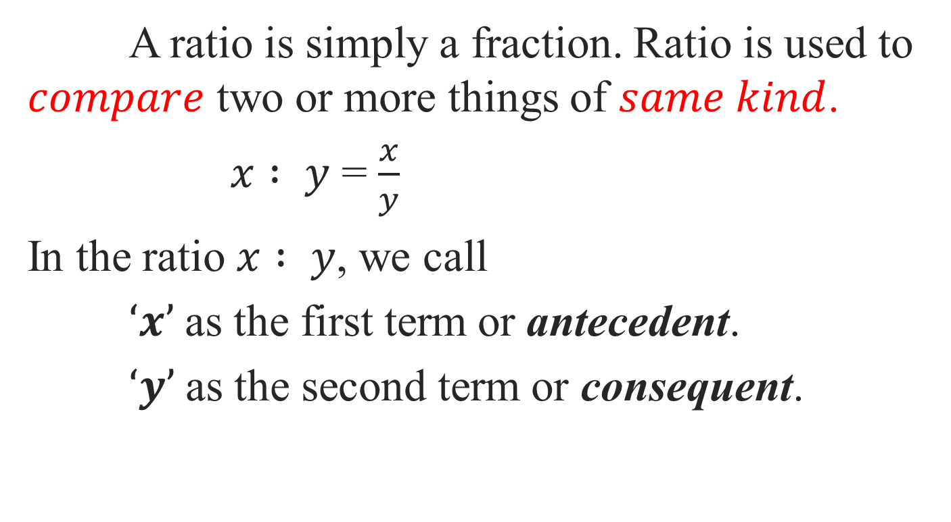
Ratio
A ratio is simply a fraction. Ratio is used to $compare$ two or more things of $same kind$.
$x : y$ = $\frac{x}{y}$
In the ratio $x : y$, we call
$‘x’$as the first term or antecedent.
$‘y’$as the second term or consequent.

Slide 3
Types of Ratios
1)Duplicate Ratio
2)Sub-Duplicate Ratio
3)Triplicate Ratio
4)Sub-Triplicate Ratio
5)Inverse Ratio
6)Compound Ratio

Slide 4
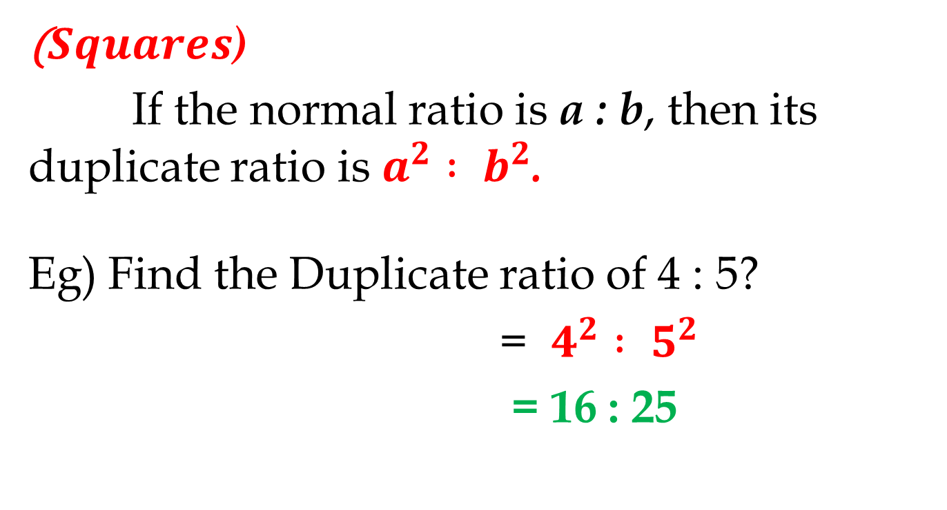
1) Duplicate Ratio
($Squares$)
If the normal ratio is a : b, then its duplicate ratio is $a^{2} : b^{2}$.
Eg) Find the Duplicate ratio of 4 : 5?
= $4^{2} : 5^{2}$
= 16 : 25

Slide 5
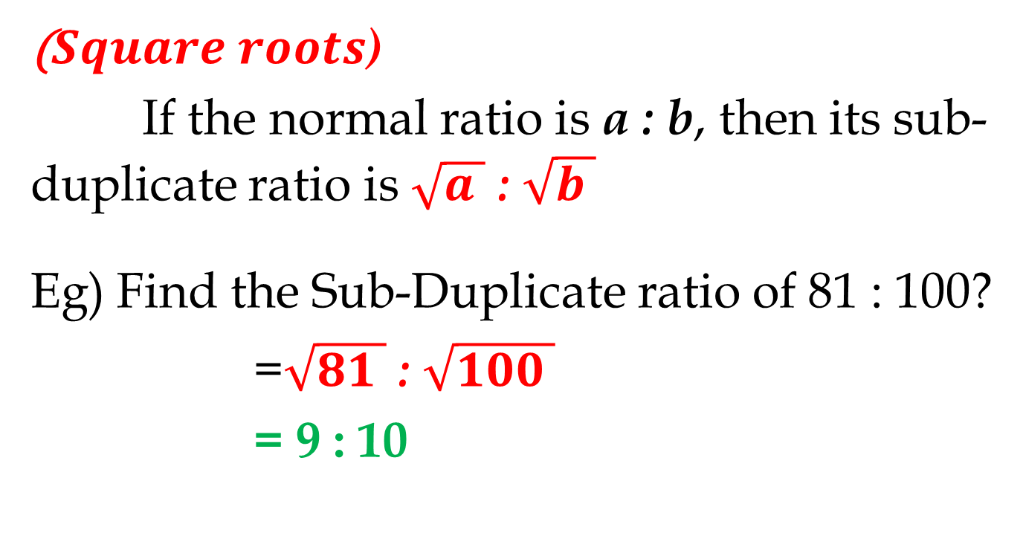
2) Sub-Duplicate Ratio
($Square roots$)
If the normal ratio is a : b, then its sub-duplicate ratio is $\sqrt{a }$ : $\sqrt{b }$
Eg) Find the Sub-Duplicate ratio of 81 : 100?
=$\sqrt{81 }$ : $\sqrt{100 }$
= 9 : 10

Slide 6
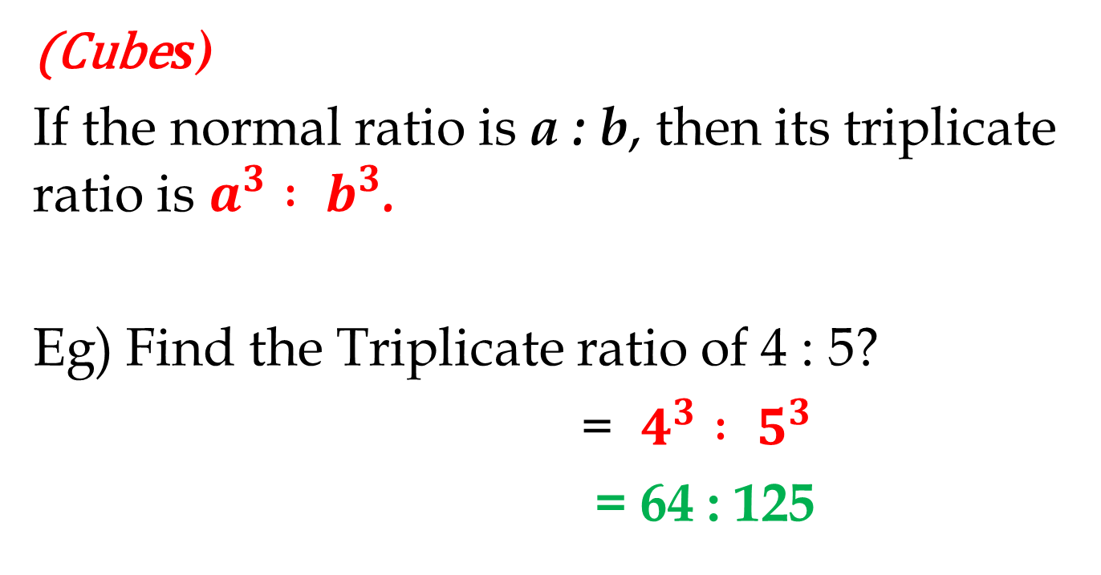
3) Triplicate Ratio
(Cube$s$)
If the normal ratio is a : b, then its triplicate ratio is $a^{3} : b^{3}$.
Eg) Find the Triplicate ratio of 4 : 5?
= $4^{3} : 5^{3}$
= 64 : 125

Slide 7
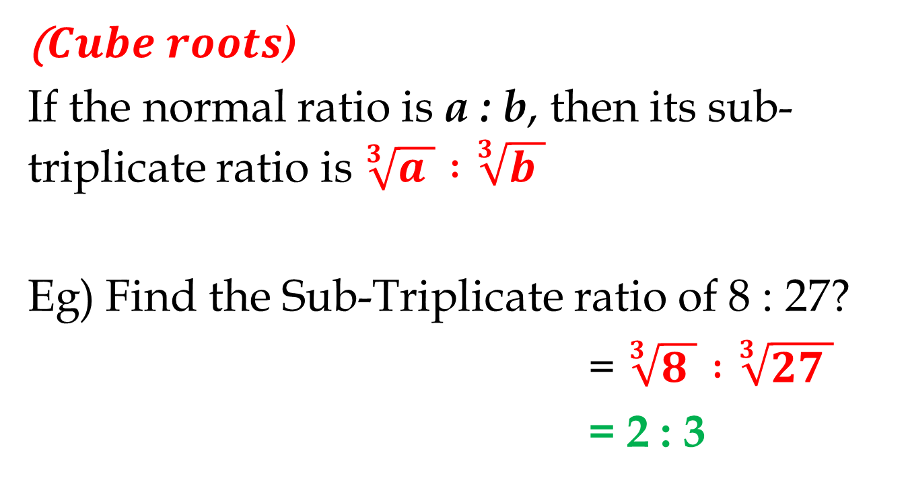
4) Sub-Triplicate Ratio
($Cube roots$)
If the normal ratio is a : b, then its sub-triplicate ratio is $\sqrt[3]{a } :\sqrt[3]{b }$
Eg) Find the Sub-Triplicate ratio of 8 : 27?
= $\sqrt[3]{8 } :\sqrt[3]{27 }$
= 2 : 3

Slide 8
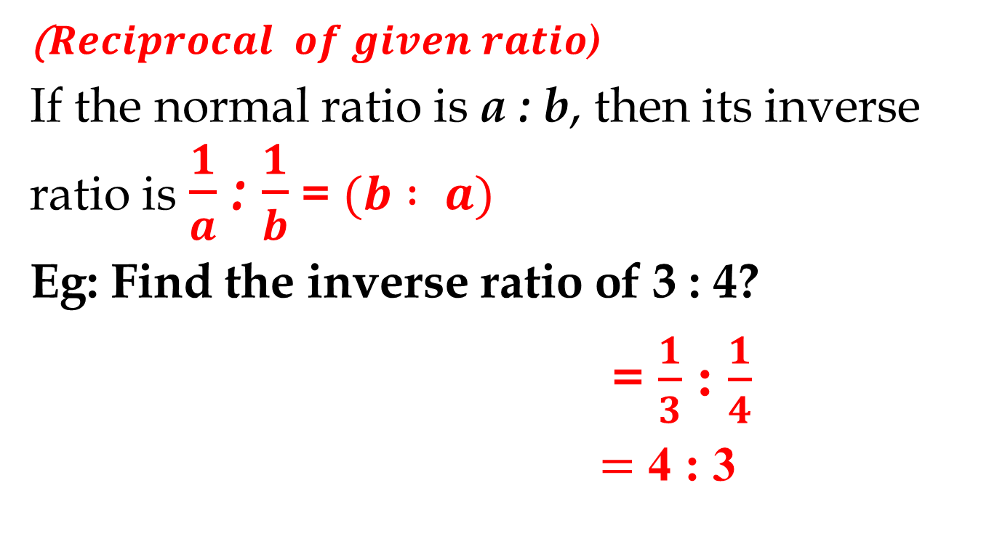
5) Inverse Ratio
($Reciprocal of given ratio$)
If the normal ratio is a : b, then its inverse ratio is $\frac{1}{a}$ : $\frac{1}{b}$ = $(b : a)$
Eg: Find the inverse ratio of 3 : 4?
= $\frac{1}{3}$ : $\frac{1}{4}$
$=$ 4 : 3

Slide 9
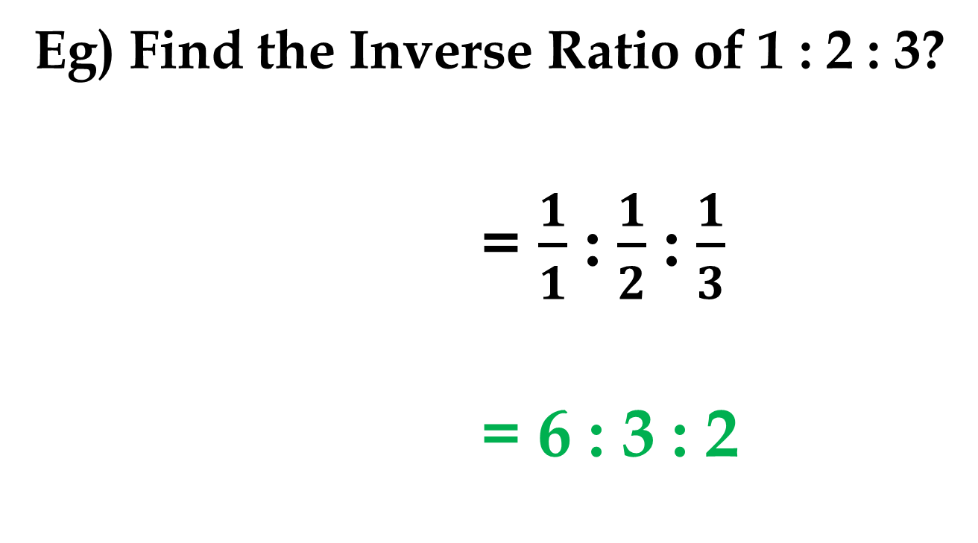
5) Inverse Ratio…
Eg) Find the Inverse Ratio of 1 : 2 : 3?
= $\frac{1}{1}$ : $\frac{1}{2}$ : $\frac{1}{3}$
= 6 : 3 : 2

Slide 10
6) Compound Ratio
(Product of all 1st term) : (Product of all 2nd term)
Eg) Find the compound ratio of (a : b) (c : d) (e : f)
= (ace : bdf)

Slide 11
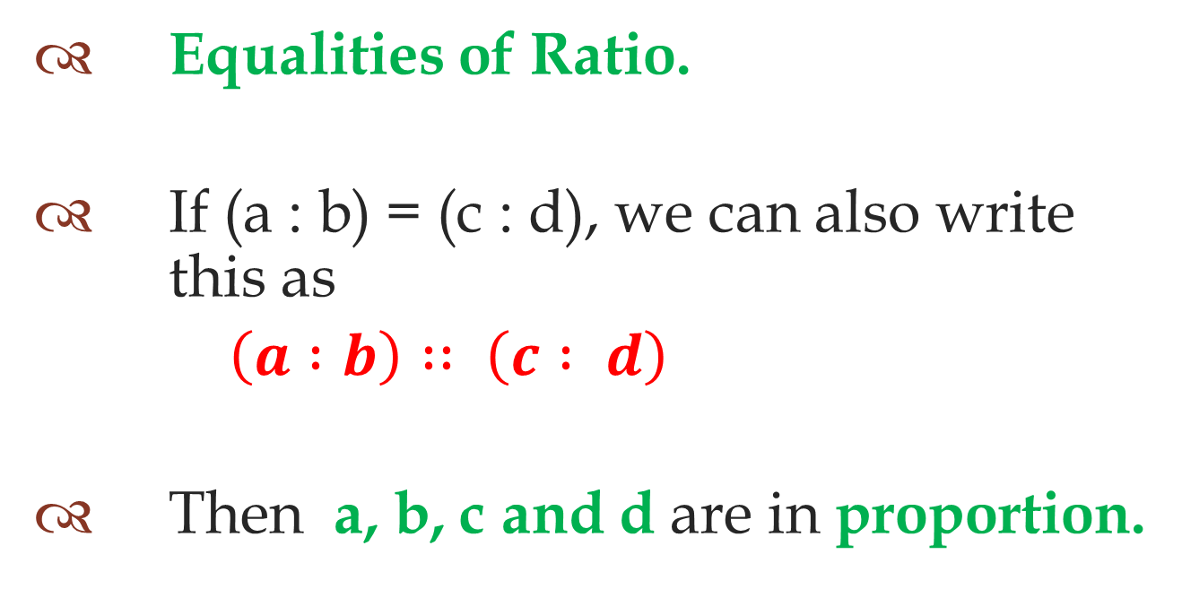
Proportion
Equalities of Ratio.
If (a : b) = (c : d), we can also write this as
$\left(a :b\right) : : \left(c : d\right)$
Then a, b, c and d are in proportion.

Slide 12
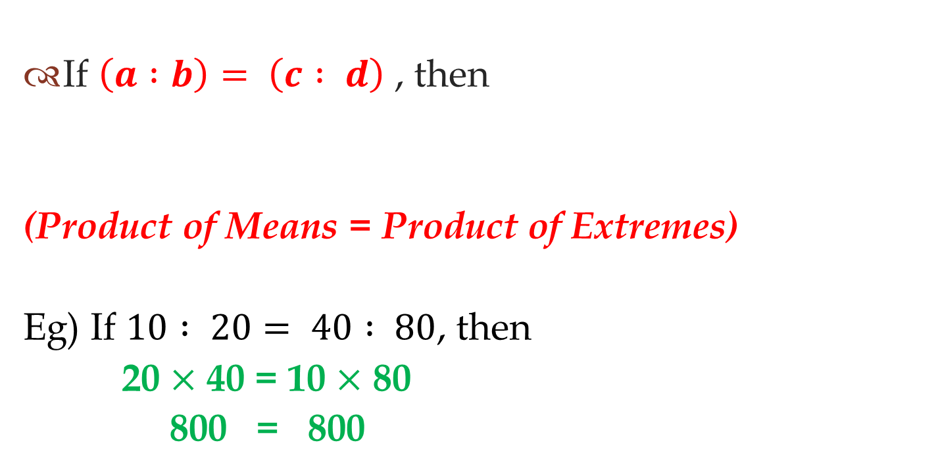
Proportion
If $\left(a :b\right)= \left(c : d\right)$ , then
(Product of Means = Product of Extremes)
Eg) If $10 : 20= 40 : 80$, then
20 $×$ 40 = 10 $×$ 80
800 = 800

Slide 13
Basic Problems

Slide 14
Q.1)
A : B = 3 : 4 and B : C = 4 : 5
then find A : B : C
a)3:4:5 b)5:4:3 c)6:8:9 d)3:4:9

Slide 15
Q.1)Explanation
A : B : C
3 : 4
4 : 5
3 : 4 : 5
A : B : C = 3 : 4 : 5

Slide 16
Q.2)
A : B = 2 : 3 and B : C = 6 : 5
then find A : B : C
a)2:6:5 b)5:6:5 c)4:3:5 d)4:6:5

Slide 17
Q.2)Explanation
A : B : C
2 : 3
: 3
6 :
6 : 5
12 : 18 : 15
4 : 6 : 5
A : B : C = 4 : 6 : 5

Slide 18
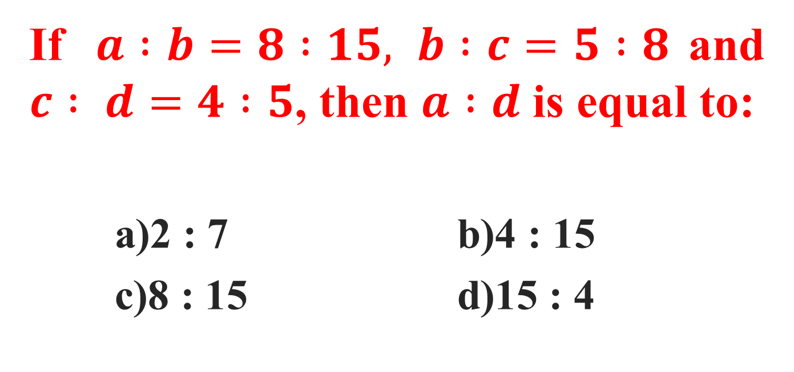
Q.3)
If $a :b=8 :15, b :c=5 :8$and $c : d=4 :5$, then $a :d$is equal to:
a)2 : 7 b)4 : 15
c)8 : 15 d)15 : 4

Slide 19

Q.3)Explanation
A : B : C : D
8 : 15
: 15 : 15
5 :
5 : 8
: 8
4 : 4 :
4 : 5
4 : 15
$∴$A : D = 4 : 15

Slide 20
Q.4)
If 2A = 3B, then find A : B.
a)2 : 3 b)3 : 2

Slide 21
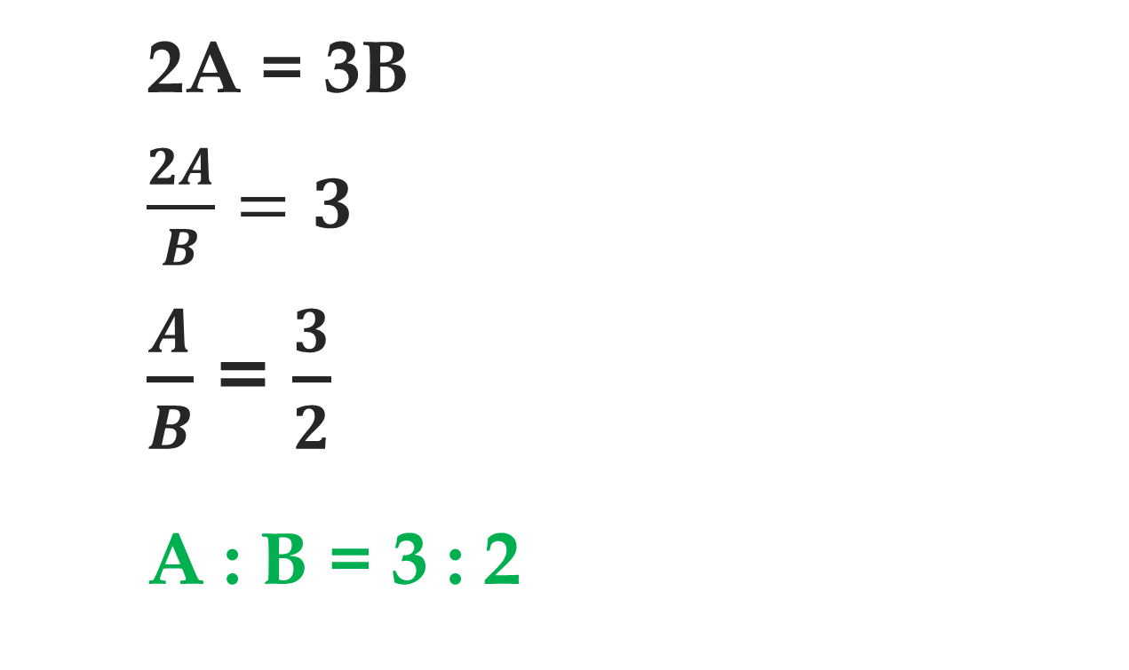
Q.4)Explanation
2A = 3B
$\frac{2A}{B}=3$
$\frac{A}{B}$ = $\frac{3}{2}$
A : B = 3 : 2

Slide 22
Q.5)
If 2A = 3B = 4C, then A : B : C is?
a)2 : 3 : 4 b)4 : 3 : 2
c)6 : 4 : 3 d)3 : 4 : 6

Slide 23
Q.5) Explanation
If 2A = 3B then,
A : B = 3 : 2
If 3B = 4C then,
  B : C = 4 : 3
A : B : C
3 : 2
: 2
4 :
4 : 3
12 : 8 : 6
6 : 4 : 3
Then A : B : C = 6 : 4 : 3

Slide 24
Q.6)
If one fourth of A is equal to two fifth of B, then Find the ratio of A and B.
a)5 : 8 b)8 : 5
c)6 : 5 d)8 : 3

Slide 25
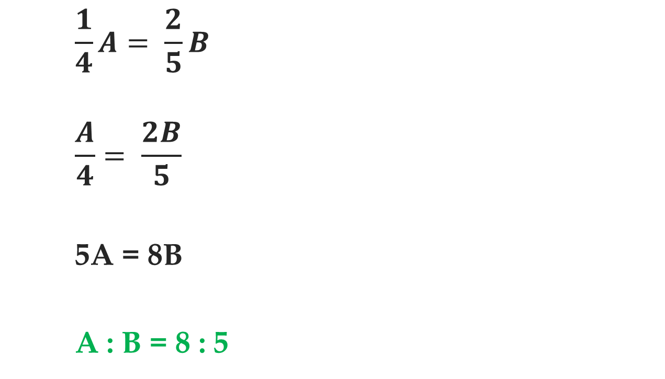
Q.6)Explanation
    $$\frac{1}{4}A= \frac{2}{5}B$$
    $$\frac{A}{4}= \frac{2B}{5}$$
    5A = 8B
    A : B = 8 : 5

Slide 26
Type 1: Problems
Given :
    Total
    Ratio to Split the total
Question:
    Individual Values

Slide 27
Q.7)
In a parking there are 180 vehicles (Cars and Bikes). Cars and bikes are in the ratio of 4 : 5. Find the total number of bikes in that parking?
a)80 b)100
c)120 d)90

Slide 28
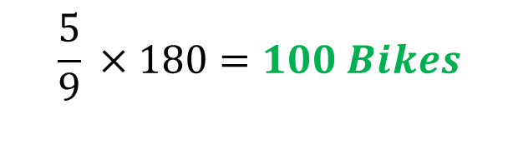
Q.7) Explanation
Total Vehicles
180
4
5
:
Cars
Bikes
$$\frac{5}{9} ×180=100 Bikes$$

Slide 29
Q.7) Explanation (Alternate Method)
Total Vehicles
4x + 5x = 180
9x = 180
x = 180/9 => 20
x = 20
Bikes = 5x
= 5(20)
= 100 bikes
180
4
5
:
Cars
Bikes
4x
5x

Slide 30
Q.8)
A sum of Rs.9000 is to be distributed among A, B and C in the ratio 4 : 5 : 6. What will be the difference between A and C’s shares?
(a) Rs. 600 (b) Rs. 1000
(c) Rs. 900 (d) Rs. 1200

Slide 31

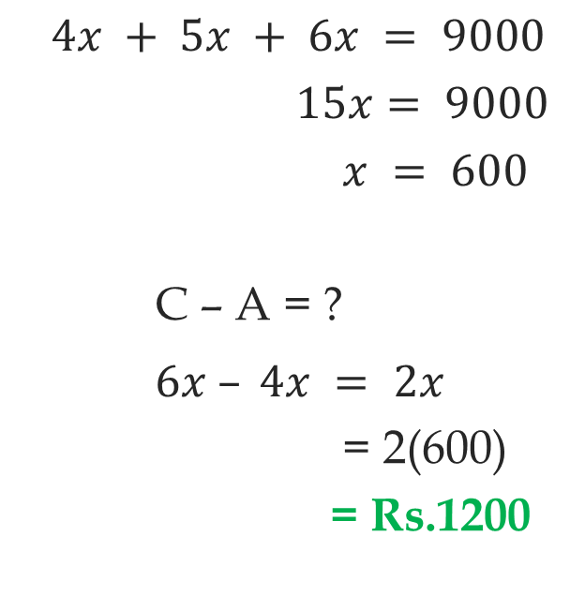


Q.8) Explanation
C – A = ?
$$4x + 5x + 6x = 9000$$
$15x= 9000$
$x = 600$
C – A = ?
$6x – 4x = 2x$
= 2(600)
= Rs.1200
Rs.9000
4
:
5
:
6
A
B
C
$$4x$$
5$x$
6$x$

Slide 32
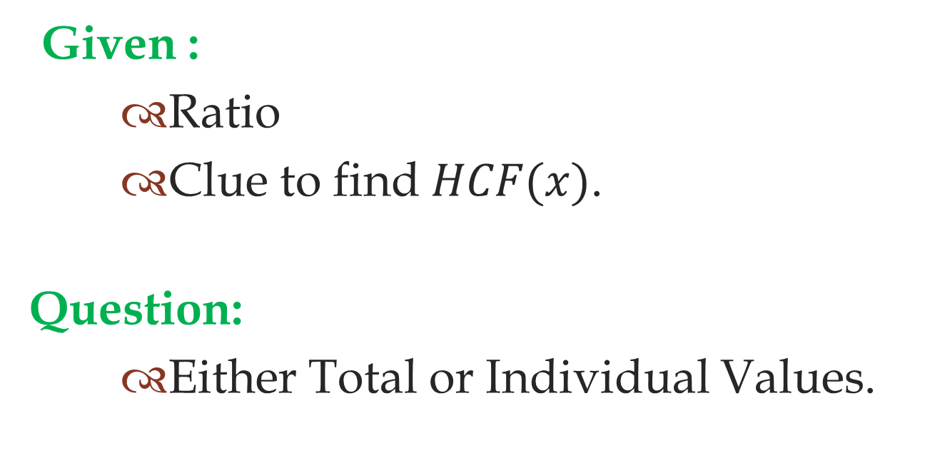
Type 2: Problems
Given :
    Ratio
    Clue to find $HCF(x)$.
Question:
    Either Total or Individual Values.

Slide 33
Q.9)
Pencils, pens and books in a shop are in the ratio of 10 : 2 : 3. If there are 120 pencils, the number of books in the shop is:
a)36 b)48 c)72 d)40

Slide 34

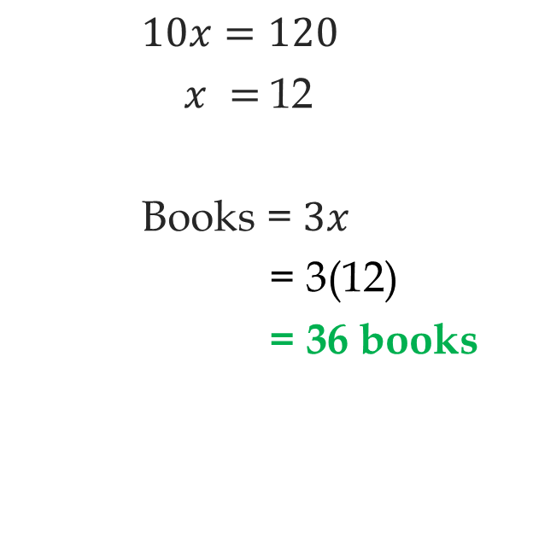


Q.9) Explanation
$10x=120$
$x =$12
Books = $3x$
= 3(12)
= 36 books
Stationaries
10
:
2
:
3
Pencil
Pen
Books
10$x$
2$x$
3$x$
Total no of Pencils = 120

Slide 35
Q.10)
A sum of money is divided among A, B, C and D in the ratio of 3 : 4 : 9 : 10 respectively. If the difference between C’s share and B’s share is Rs.1500, then what is the total amount of money A and D receive together?
(a) Rs. 1300 b) Rs. 2600
(c) Rs. 3900 (d) Rs. 5200

Slide 36

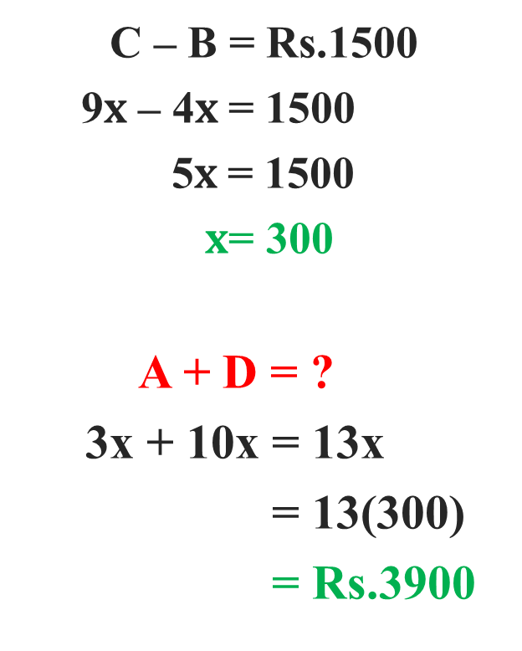



Q.10) Explanation
A + D = ?
  C – B = Rs.1500
  9$x$ – 4$x$= 1500
  5$x$= 1500
  $x$= 300
A + D = ?
3x + 10x = 13x
= 13(300)
= Rs.3900
Sum of Money
3
:
4
:
9
:
10
A
B
C
D
3$x$
$$4x$$
9$x$
10$x$

Slide 37
Two Ratios Based Problems
Q.11)
Two numbers A and B are in the ratio of 3 : 4. If each number is increased by 20, then the new ratio becomes 5:6. Find the value of B.
a)40 b)48
c)50 d)55

Slide 38
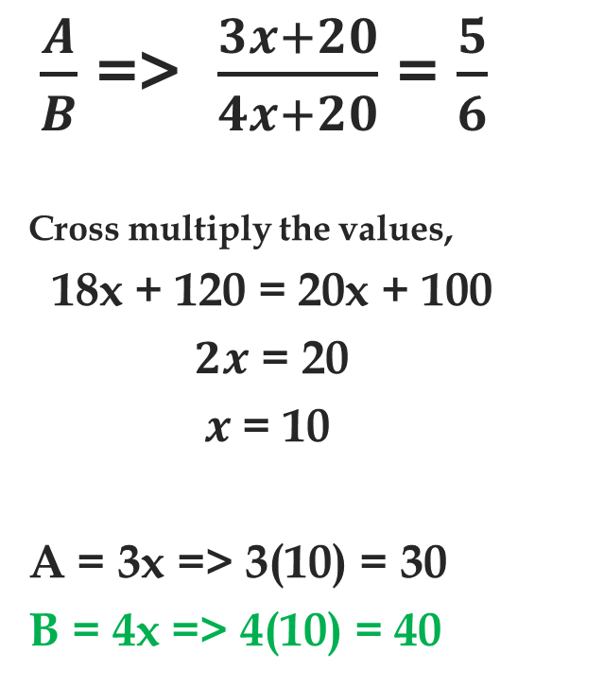
Q.11)Explanation
$\frac{A}{B}$ => $\frac{3x+20}{4x+20}$ = $\frac{5}{6}$
Cross multiply the values,
18x + 120 = 20x + 100
$2x$ = 20
$x$= 10
A = 3x => 3(10) = 30
B = 4x => 4(10) = 40
A
B
3
:
4
+20
3x
4x
+20
5
:
6

Slide 39
Q.11)Shortcut
A = 3R = 3(10) = 30
B = 4R = 4(10) = 40
A
B
3
:
4
2R
2R
5
:
6
2R = 20
1R = 10

Slide 40
Two Ratios Based Problems
Q.12)
Two numbers P and Q are in the ratio of 7 : 9. If each number is decreased by 24, then the new ratio becomes 3 : 5. Find the sum of P and Q.
a)80 b)96
c)64 d)112

Slide 41
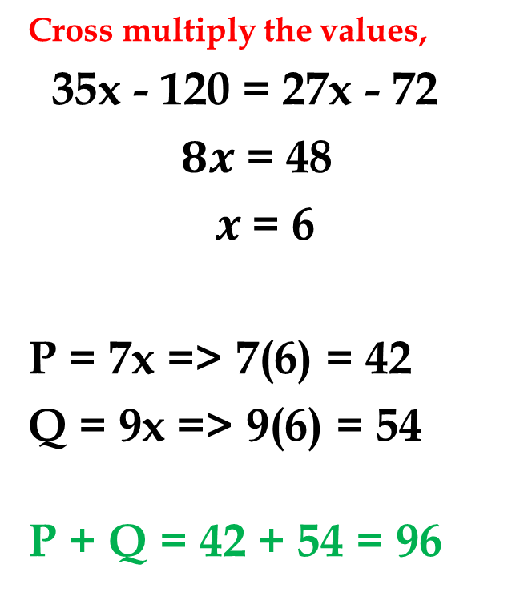
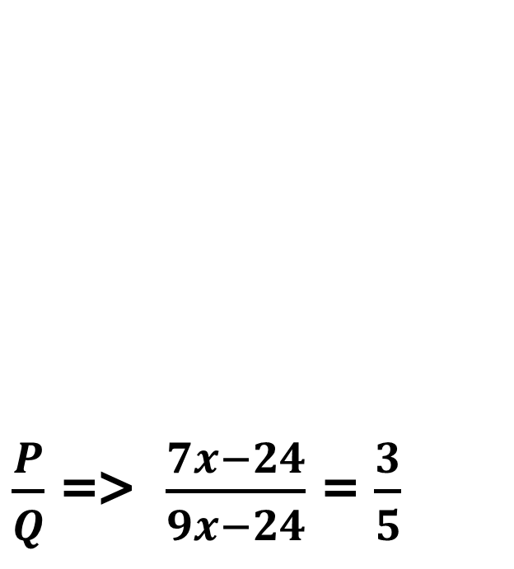
12)Explanation
$\frac{P}{Q}$ => $\frac{7x−24}{9x−24}$ = $\frac{3}{5}$
Cross multiply the values,
35x - 120 = 27x - 72
$8x$ = 48
$x$= 6
P = 7x => 7(6) = 42
Q = 9x => 9(6) = 54
P + Q = 42 + 54 = 96
P
Q
7
:
9
- 24
7x
9x
- 24
3
:
5

Slide 42
12)Shortcut
P = 7R = 7(6) = 42
Q = 9R = 9(6) = 54
P + Q = 42 + 54 = 96
or
P + Q = 7R + 9R
= 16 R
P + Q = 16(6) = 96
P
Q
7
:
9
4R
4R
3
:
5
4R = 24
1R = 6

Slide 43
Q.13)
Two numbers A and B are in the ratio of 6:11. If each number is increased by 8 new the ratio becomes 2 : 3. Find the new value of B.
a)22 b)34
c)60 d)17

Slide 44
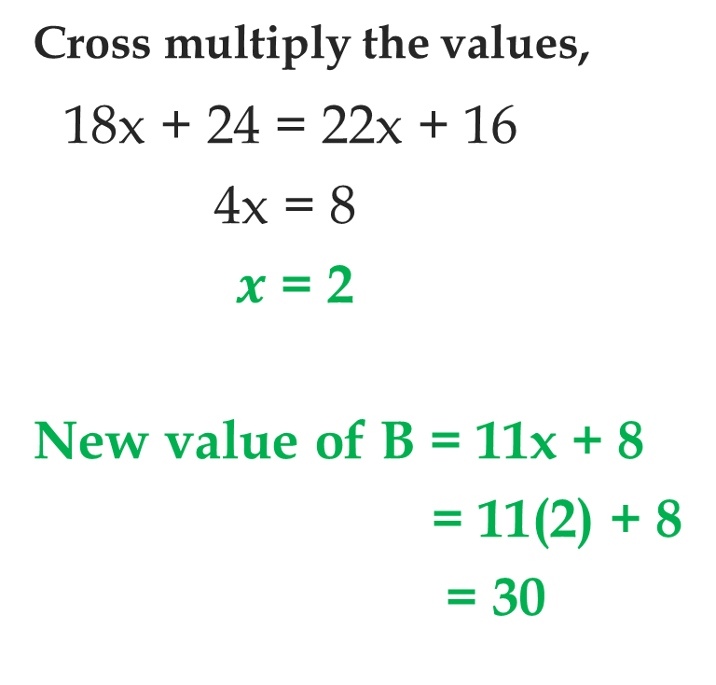
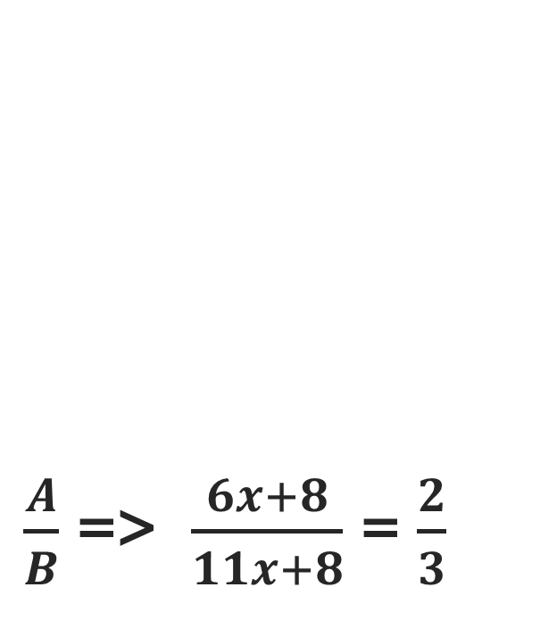
Q.13) Explanation
$\frac{A}{B}$ => $\frac{6x+8}{11x+8}$ = $\frac{2}{3}$
Cross multiply the values,
18x + 24 = 22x + 16
4x = 8
$x$ = 2
New value of B = 11x + 8
= 11(2) + 8
= 30
A
B
6
:
11
+8
6x
11x
+8
2
:
3

Slide 45
Q.13) Shortcut
A
B
A
B
5
Old Value--→
6
:
11
6
:
11
4R
4R
- 4R
- 8R
:
10
15
New Value--→
:
2
3
4R = 8
1
1R = 2
New value of B = 15R
= 15(2)
= 30

Slide 46
Q.14)
The present age of A and B are in the ratio of 2 : 5. After 8 years, the ratio of their ages will become 1 : 2. Find the present age of B.
a)45 years b)50 years
c)40 years d)60 years

Slide 47
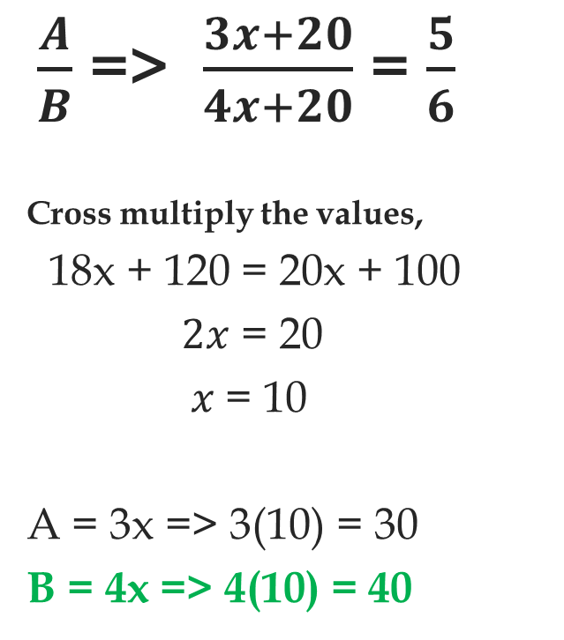
Q.14) Explanation
$\frac{A}{B}$ => $\frac{2x+8}{5x+8}$ = $\frac{1}{2}$
Cross multiply the values,
4x + 16= 5x + 8
$x$ = 8
B = 5x => 5(8) = 40 years
A
B
2
:
5
+ 8
2x
5x
+ 8
1
:
2

Slide 48
Q.14) Shortcut
A
B
3
A
B
2
:
5
2
:
5
- 1R
- 3R
1R
1R
:
:
1
2
3
6
1
1R = 8
B’s age = 5(8)
= 40 years

Slide 49
Q.15)
A mixture contains milk and water in the ratio of 5:4. If 4 liters of water is added to that mixture the ratio becomes 9:8. What is the initial amount of water in that mixture:
a)32 liters b)34 liters
c)36 liters d)38 liters

Slide 50
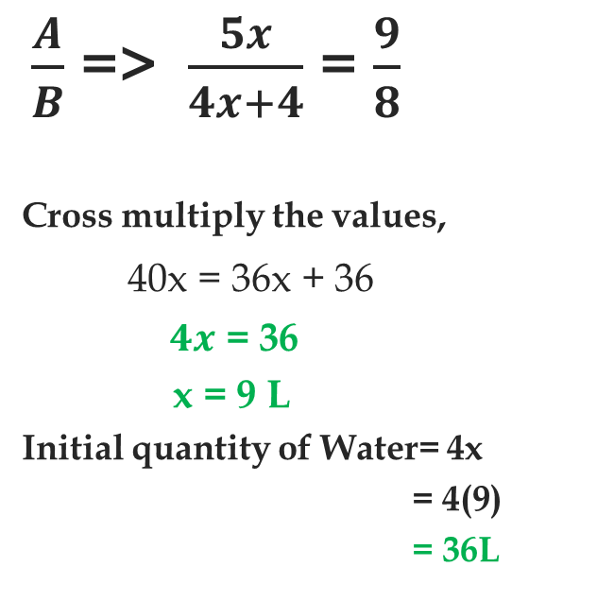
Q.15) Explanation
$\frac{A}{B}$ => $\frac{5x}{4x+4}$ = $\frac{9}{8}$
Cross multiply the values,
40x = 36x + 36
$4x$ = 36
x = 9 L
Initial quantity of Water= 4x
= 4(9)
= 36L
Milk
Water
5
:
4
5x
4x
4 L
9
:
8

Slide 51
Q.16)
The ratio of income of A to that of B is 3:2 and the expenditure of A to that of B is 2:1. If at the end of the year, each saves Rs.5000, then the income of A is:
a) Rs.15,000 b) Rs.10,000 c) Rs.20,000 d) Rs.25,000

Slide 52
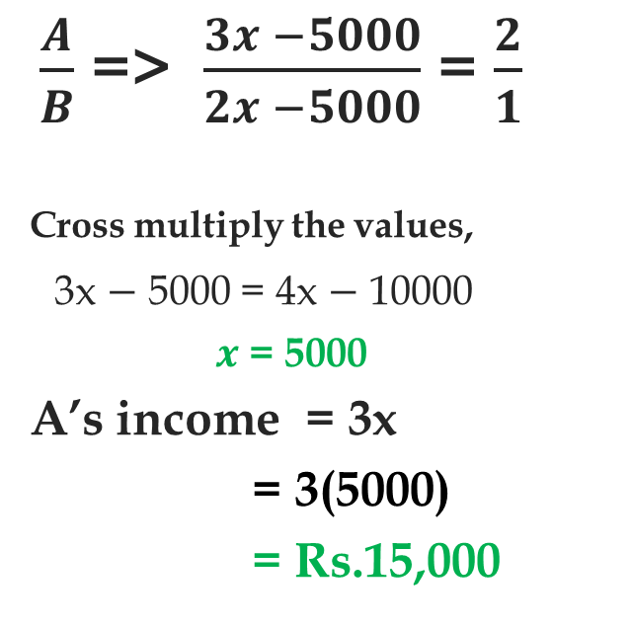
Q.16) Explanation
$\frac{A}{B}$ => $\frac{3x −5000}{2x −5000}$ = $\frac{2}{1}$
Cross multiply the values,
3x $−$ 5000 = 4x $−$ 10000
$x$ = 5000
A’s income = 3x
= 3(5000)
= Rs.15,000
A
B
Income
3
:
2
- 5000
3x
2x
- 5000
:
Expenditure
2
1

Slide 53
Q.17)
The sum of the squares of three positive number is 608 and they are in the ratio 2:3:5, then find the sum of all three numbers?
a)38 b)40
c)42 d)44

Slide 54
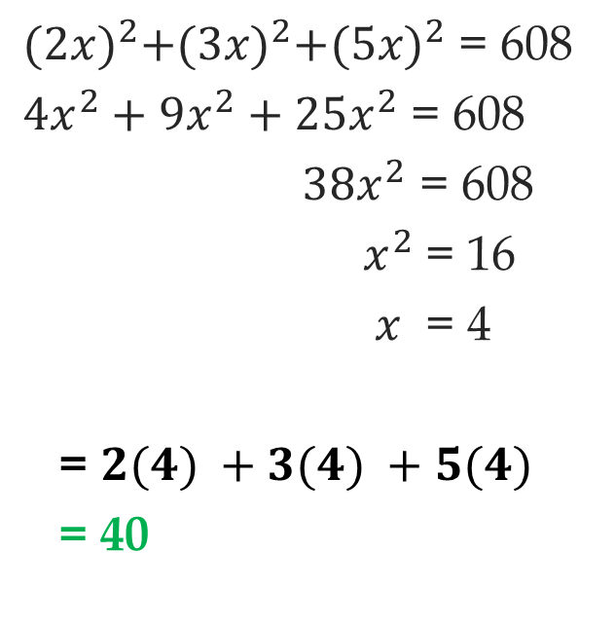
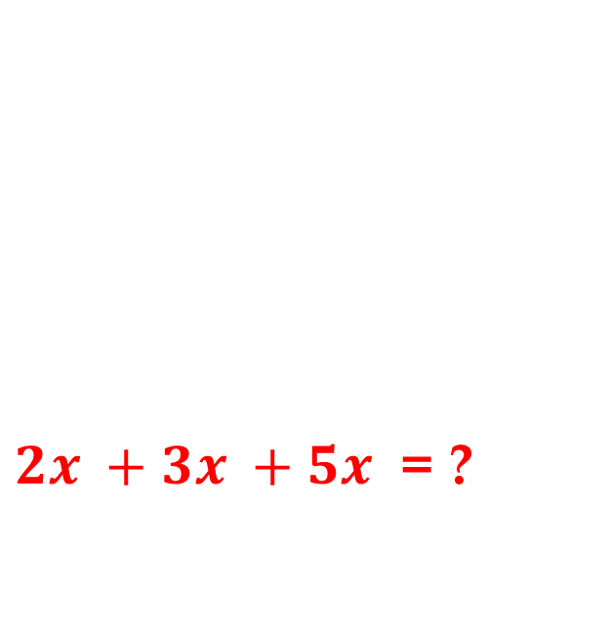
Q.17)Explanation
${2x}^{ }+{3x}^{ }+{5x}^{ }$ = ?
${(2x)}^{2}+{(3x)}^{2}+{(5x)}^{2}$ = 608
${4x}^{2}+{9x}^{2}+{25x}^{2}$ = 608
${38x}^{2}$ = 608
$x^{2}$ = 16
$x^{ }$ = 4
= ${2(4)}^{ }+{3(4)}^{ }+{5(4)}^{ }$
= 40
A
B
C
:
:
2
3
5
2x
3x
5x

Slide 55
Q.18)
A bag contains Rs.102 in the form of 1rupee, 50 paisa and 10 paisa coins in the ratio 3:4:10. The number of 10 paisa coins is:
a)340 b)60 c)80 d)170

Slide 56
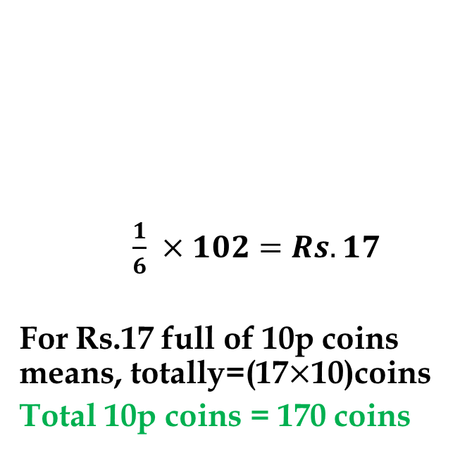
Q.18) Explanation
Rs.102
$\frac{1}{6} ×102=Rs.17$
For Rs.17 full of 10p coins means, totally=(17$×$10)coins
Total 10p coins = 170 coins
Rs.102
Re.1
50 p
10 p
Re.1
50 p
10 p
100p
3 : 2 : 1
No of Coins Ratio
3 : 4 : 10
Rupees Ratio
3(100) : 4(50) : 10(10)
300 : 200 : 100
3 : 2 : 1

Slide 57
Q.19)
Rs.180 contained in a box consists of one rupee, 50 paisa and 25 paisa coins in the ratio of 2 : 3 : 4. What is number of 50 paisa coins?
a) 60 b)180 c) 120 d)140

Slide 58
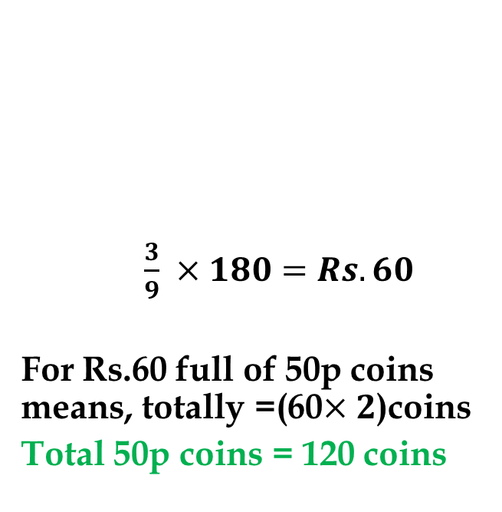
Q.19) Explanation
Rs.180
$\frac{3}{9} ×180=Rs.60$
For Rs.60 full of 50p coins means, totally =(60$×2$)coins
Total 50p coins = 120 coins
Rs.180
Re.1
50 p
25 p
Re.1
50 p
25 p
100p
4 : 3 : 2
No of Coins Ratio
2 : 3 : 4
Rupees Ratio
2(100) : 3(50) : 4(25)
200 : 150 : 100
4 : 3 : 2

Slide 59
Q.20)
In a farm there are few hens and sheep. If heads are counted, there are 120 and if the legs are counted, there are 390. Find the total no of hens in that farm?
a)60 b)45
c)90 d)75

Slide 60



Q.20) Explanation
Total Animals
120
2x + 480 – 4x = 390
2x = 90
x = 45
Hens = x => 45
Sheep = 120 – x => 75
$$x$$
120 $− x$
Hens
Sheep
2$x$ + 4(120 $– x$) = 390

Slide 61
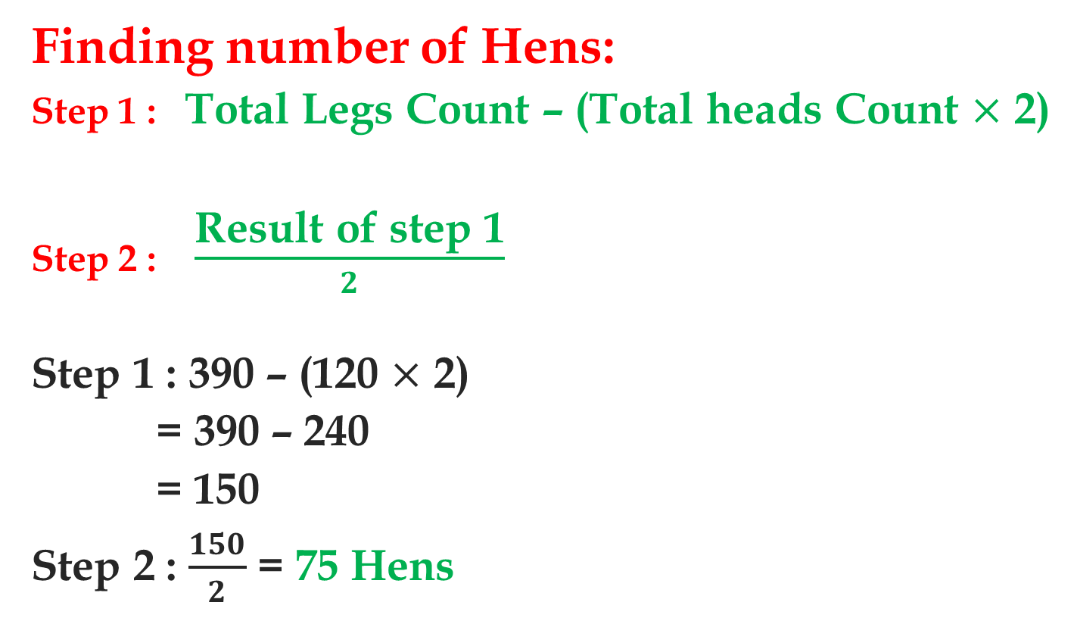
Q.20)Shortcut
Finding number of Hens:
Step 1 : Total Legs Count – (Total heads Count $×$ 2)
Step 2 : $\frac{\text{Result} \text{of} \text{step}\text{ 1}}{2}$
Step 1 : 390 – (120 $×$ 2)
= 390 – 240
= 150
Step 2 : $\frac{150}{2}$ = 75 Hens

Slide 62
Q.21)
In a farm there are few hens and sheep. If heads are counted, there are 200 and if the legs are counted, there are 580. How many sheeps are there?
a)100 b)90 c)110 d)120

Slide 63


Q.21) Explanation
Total Animals
200
2x + 800 – 4x = 580
2x = 220
x = 110
Pigeons = x => 110
Rabbits = 200 – x => 90
$$x$$
200 $− x$
Pigeons
Rabbits
2$x$ + 4(200 $– x$) = 580

Slide 64
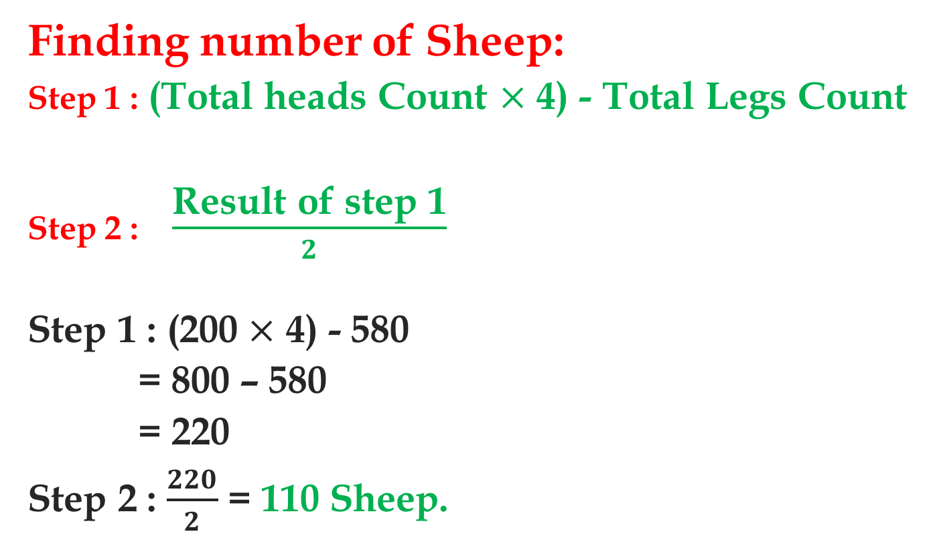
Q.21)Shortcut
Finding number of Sheep:
Step 1 : (Total heads Count $×$ 4) - Total Legs Count
Step 2 : $\frac{\text{Result} \text{of} \text{step}\text{ 1}}{2}$
Step 1 : (200 $×$ 4) - 580
= 800 – 580
= 220
Step 2 : $\frac{220}{2}$ = 110 Sheep.

